Slide 1
Explain, Explore and Engage A Social Prescribing and Physical Activity Tool
1
2
Overview
Explaining Social Prescribing
Explore Tool
Engage tool
Resource Library
3
4
How to use this document Click here
5

Slide 2
How to use this document
.
The Exploratory Tool takes you through a step-by-step process, supported by the Resource Library and System Connector.
View this document in Slide show format from beginning to get the best experience
Click on the home button on the bottom right of each page to return to the main menu
Click on the grey arrow on the bottom right of each page to return to the previous page
Click on text that is underlined to use links to documents/resources

Slide 3
Overview
This menu of tools is intended to develop the integration of physical activity within social prescribing.
It aims to support i) identification of relevant stakeholders, ii) understanding of how pathways and systems currently operate, iii) co-development of action to address identified needs.
The menu includes the following four sections;
A) Explain: the basics of social prescribing, including roles, how it fits within NHS structures and why it is so important.
B) Explore: to enable organisations to explore their knowledge of local social prescribing and physical activity systems. Identifying gaps, opportunities and barriers to support their work within this area.
C) Engage: to support organisations to engage with other key stakeholders within the system to encourage connection, collaboration and partnership working.
D) The Resource Library: useful guides, resources and information, to provide essential learning for a variety of audiences (e.g., Link Workers, physical activity providers and clinical staff)
About the Regional Social Prescribing and Physical Activity Team

Slide 4
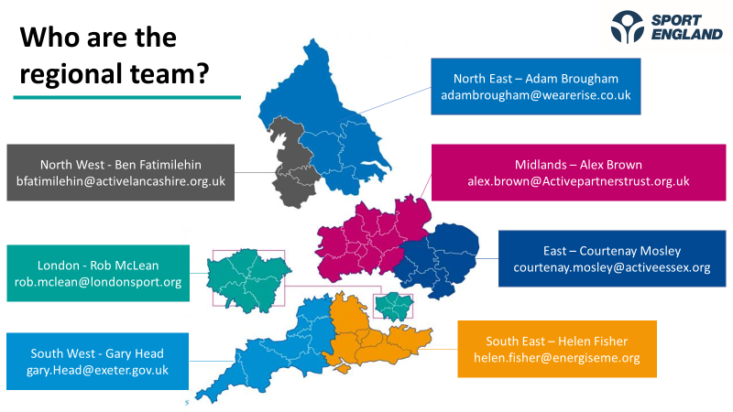
Sport England have invested National Lottery funding in seven part-time regional social prescribing and physical activity roles that are hosted by suitable, local organisations within each region. These roles are designed to respond to the unique needs of their region, as well as providing leadership and building critical relationships across their region, maintaining a primary focus on supporting and enabling the VCFSE to integrate and enhance physical activity provision as a core pillar of their work to support individuals’ health and wellbeing. The roles are closely linked to the 43 Active Partnerships across England. Active Partnerships are locally-led, non-profit, strategic organisations covering the whole of England, bringing together people and organisations to increase physical activity levels. More information on Active Partnerships can be found by clicking the logo…
About Us
Contact us
North West - Ben Fatimilehin
North East – Adam Brougham
London – Rob McLean
Midlands – Alex Brown
East – Courtenay Mosley
South East – Helen Fisher
South West – Gary Head

Slide 5
Explaining Social Prescribing
What is Social Prescribing?
Why is Social Prescribing important?
National Academy for Social Prescribing (NASP)
Social Prescribing Roles and Personalised care
Social Prescribing and Physical Activity
NHS Infrastructure – Integrated Care Systems

Slide 6
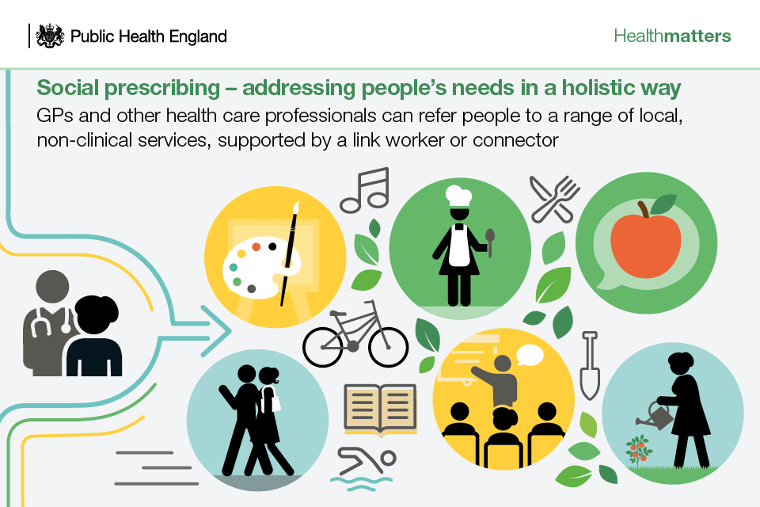
What is Social Prescribing?
‘An approach that connects people to activities, groups, and services in their community to meet the practical, social and emotional needs that affect their health and wellbeing’ (NHS England)
‘A way of actively connecting people to activities, information and resources to help address an unmet health and wellbeing need or risk’ (National Academy for Social Prescribing)
‘A means of enabling health professionals to refer people to a range of local, non-clinical services’ (Kings Fund)
Further reading linked to ‘What is Social Prescribing’ found here
.

Slide 7
Why is Social Prescribing important?
Social Prescribing helps people to receive bespoke non-medical support where and when they need it.
It takes pressure off the NHS – reduces the need for GP appointments about non-medical issues.
Social Prescribing tackles some of our most significant health inequalities
With up to one in five GP appointment about wider social needs rather than medical issues, social prescribing can play an important role in integrated care, supporting people waiting for elective care, reducing overprescribing and tackling loneliness.
“
‘There is a growing body of evidence that social prescribing reduces pressure on the NHS by directing people to more appropriate services and groups – an evidence summary published by the University of Westminster suggests that where an individual has support through social prescribing, their GP consultations reduce by an average of 28% and A&E attendances by 24%.’
Ref. Social prescribing applying all our health guidance (Gov.uk)

Slide 8
Quick Links to NASP
What is Social Prescribing?
About us
Our Vision
Physical Activity
Evidence on Social Prescribing
Webinars
Case Studies
Our mission: To help people live the best life they can through social prescribing
Social prescribing works alongside traditional healthcare to resolve issues that contribute to poor health and quality of life. It creates sustainable, supportive networks and relationships. And it connects people to non-medical support.
Who are we?
The National Academy for Social Prescribing is a national charity, founded in October 2019.
Our goal is to ensure social prescribing thrives across the whole country. We envision a vibrant, innovative, and ambitious movement. One that connects communities and mobilises hundreds of thousands of people. Each with a shared commitment to transforming lives.
Social Prescribing and Physical Activity
NASP works with national organisations including Sport England and UK Active. We do this to help connect sport and physical activity providers to the health system. And to support the Government with schemes like Active Travel Social Prescribing Pilots. You can find more guidance, support and research on the Sport England website.
Webinar: Physical activity and social prescribing

Slide 9
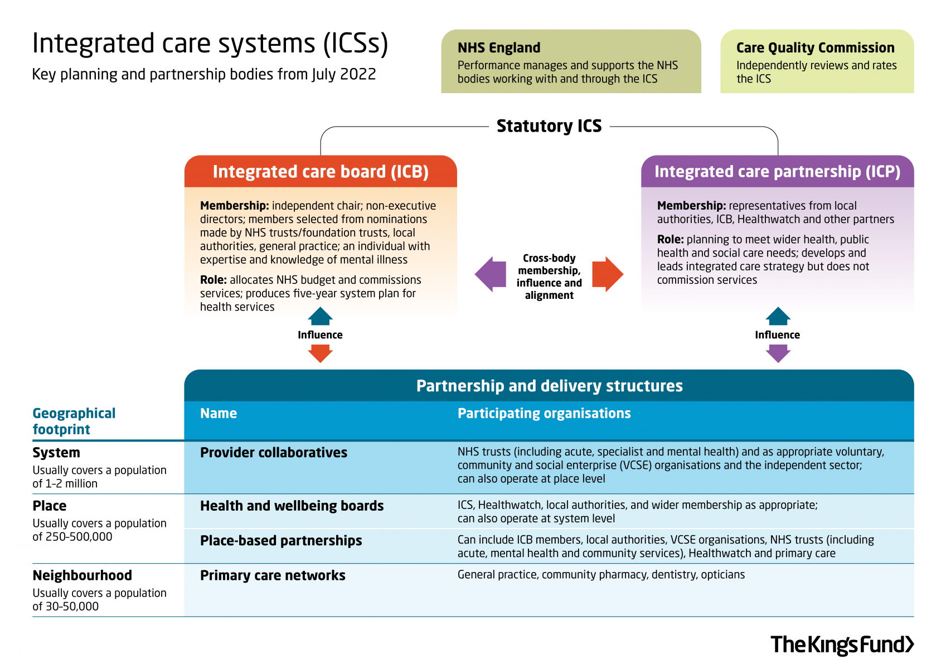
NHS Infrastructure – Integrated Care Systems
Integrated care systems (ICSs) are geographically based partnerships that bring together providers and commissioners of NHS services with local authorities and other local partners to plan, co-ordinate and commission health and care services. They are part of a fundamental shift in the way the health and care system is organised – away from competition and organisational autonomy and towards collaboration, with health and care organisations working together to integrate services and improve population health. ICSs have been developing for several years – since July 2022 the Health and Care Act has put them on a statutory footing.
The NHS cannot address all the factors that affect people’s health. Social prescribing looks at a person’s whole life through a trusted relationship between person and link worker. Similarly, we need to take a partnership approach to building the social prescribing ecosystem with local partners. ICSs present an opportunity to deliver this integrated approach to social prescribing, including leadership at place and building a thriving community sector.
The Kings Fund - NHS Infrastructure – ICS, ICP and ICB

Slide 10
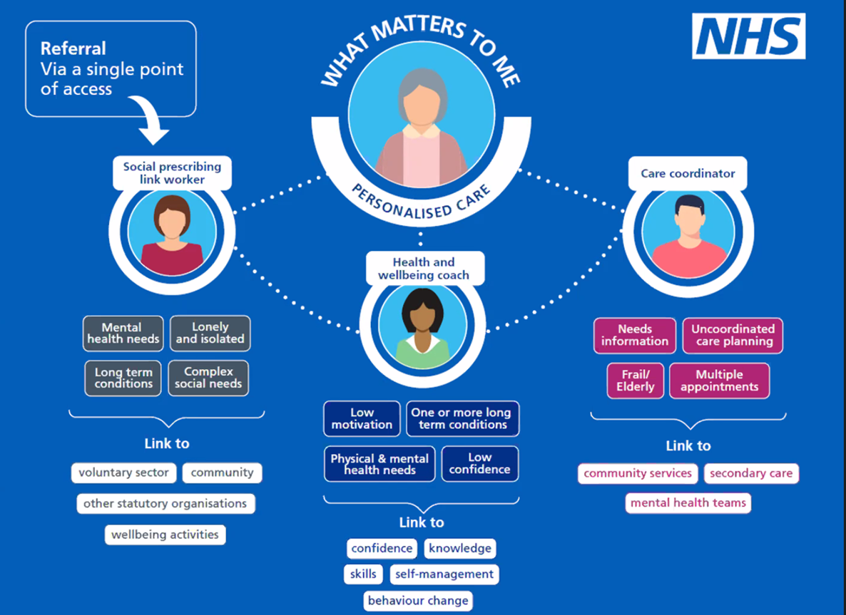
Social Prescribing Roles and Personalised Care
Social prescribing is a key component of Universal Personalised Care.
It is an approach that connects people to activities, groups, and services in their community to meet the practical, social and emotional needs that affect their health and wellbeing.
In social prescribing, local agencies such as local charities, social care and health services refer people to a social prescribing service which includes roles such as Social Prescribing Link Worker, Health and Wellbeing coach and Care Coordinator. For Information on each of these roles please use the links below…
Social Prescribing Link Worker
Health and Wellbeing Coach
Care Co-ordinator
“

Slide 11
Social Prescribing and Physical Activity
Physical activity has huge benefits for wellbeing. Benefits that go a lot deeper than physical and mental health.
When we take part in physical activity, we develop skills that help in every aspect of life. We find new friends, and we grow in confidence. We reconnect with ourselves. And we get our lives back on track.
From a health perspective, the case for physical activity is clear:
It lowers the risk of conditions including cancer, dementia, heart disease and stroke
It can lessen the risk of type 2 diabetes by 30-40%
It boosts mental wellbeing, reduces anxiety and depression, connects people, and enhances happiness and self-esteem
It helps people living with chronic illness to manage their condition
It plays a vital role in maintaining a healthy body weight, getting a good night’s sleep, and feeling more energised
And it can help you cut back on unhealthy habits like smoking, so that you live better, for longer
But many barriers prevent people from taking their first step. Lack of time or motivation can discourage us. Or we may feel too self-conscious to try something new. Perhaps health issues, disabilities or cultural reasons stop us from engaging. Or we can’t stretch to the cost of training shoes.
“
For more information please visit – NASP ‘Social prescribing and Physical Activity

Slide 12
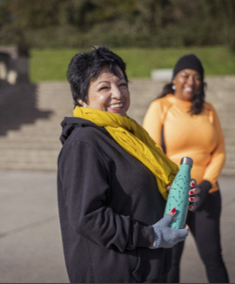
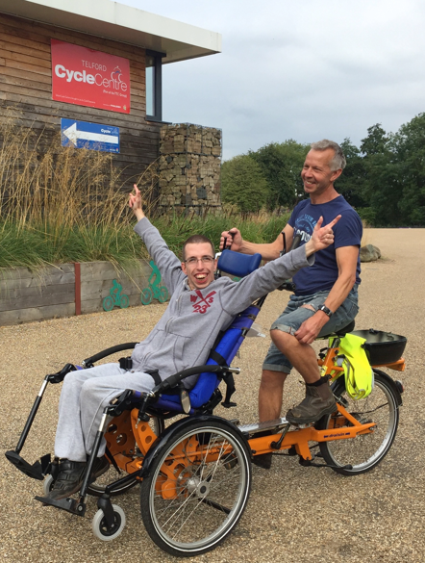
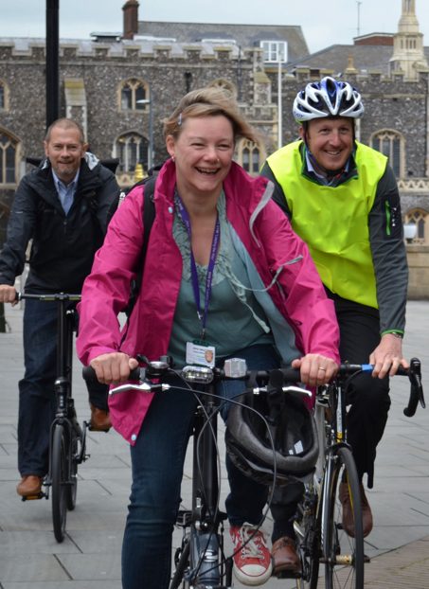
Active Partnerships
43 Active Partnerships across England
A unique feature is their independence, working across all activities, providers and audiences, focused on the needs of their local communities.
All working on the same challenge: physical inactivity and the inequalities within this.
Work collaboratively with a range of National and Local stakeholders, across sectors, taking a whole systems approach, working in a place-based way to….
Create the conditions for an active nation
Our shared purpose and shared ambition with Sport England:
To grow a Movement for Movement beyond ourselves
To get in touch with your Active Partnership, use our interactive map.

Slide 13
Exploring Social Prescribing and Physical Activity
This tool can help you explore your knowledge about key issues relevant to Physical Activity within Social Prescribing.
By using this tool, we hope you will be able to identify what you currently know about the local systems, key stakeholders, gaps in knowledge and possible opportunities for your organisation to develop. You will create an action plan which will help you prioritise your work in this area.
Step by step guide to the Exploratory tool
Exploratory Tool Template
Action Plan Template

Slide 14
Explore Tool Guide
Step 1
Step 2
Step 3
Step 4
Work through the Exploratory Tool template from left to right identifying everything you know about your local social prescribing system.
This could include –
Who you work with – organisations and individuals
Current projects/initiatives that you are aware of
Examples of good practice
We have included some ideas to help you explore the different areas of the Social Prescribing eco-system. These are divided into the 4 areas below which relate to the template –
System
Place
Neighbourhood
Individual
Once you have completed the template, spend some time reflecting on where you are strongest and to identify areas for development within your Social Prescribing and Physical Activity System.
What can you build on that is working well?
Where are the opportunities?
What are the gaps in your understanding about local systems?
Use these discussions to create an action plan for your team Action Plan Template
Contact your Regional SP/PA Advisor if you need any further support
Please use the Resource library to look up any topics which you have highlighted in your action plan.
Please revisit the explaining social prescribing section for any general information around Social Prescribing

Slide 15
Exploring your System
Explore | Explore
ICS Joint Forward Plan | Are ‘Physical Activity’, ‘Sport’, ‘Personalised Care’, ‘Social Prescribing’, ‘Health care consultations’, Lifestyle advice’,’ Healthy Lifestyles’, ‘Fitness’, ‘Exercise’, ‘Make Every Contact Count’ or similar terminology specifically mentioned in your ICS Joint Forward Plans?
ICS Priorities and Physical Activity | Do you know the key priorities for your ICS relevant to physical activity? These might relate to: Population Health Management Prevention Long Terms Heath Conditions – Treatment and Management Health Inequalities (incl Priority Groups or Communities – incl CYP) Core20PLUS5 (connected to the above)
ICB roles | Do you know the person/role with responsibility for Personalised Care/Social Prescribing within the ICB? Need to provide prompts mirroring info in the ‘explainer’ doc as to who these roles/people could be
ICB roles | Do you know the person/role with responsibility for Population Health within the ICB?
ICB roles | Do you know the person/role with responsibility for Health Inequalities within the ICB?
ICB roles | Do you know the lead contact for your ‘NHS Training Hub’ and key contacts with responsibility for training of the Primary Care workforce across the ICS?
NHS-E Regional roles | Do you know your NHS-E Regional lead for Personalised Care?
NASP role | Do you know your NASP NHS regional lead?
Sport England Regional Advisor role | Do you know your Sport England Regional Social Prescribing Physical Activity Advisor?
OHID Regional role | Do you know the Regional OHID leads for Physical Activity? Do you know their connection with the ICBs and Social Prescribing/Personalised Care?

Slide 16
Exploring your Place
Explore
Place Strategies/Plans | Are ‘Physical Activity’, ‘Sport’, ‘Personalised Care’, ‘Social Prescribing’, ‘Health care consultations’, Lifestyle advice’,’ Healthy Lifestyles’, ‘Fitness’, ‘Exercise’, ‘Make Every Contact Count’ or similar terminology specifically mentioned in Place level plans or strategies (Place Based Partnership/Health and Wellbeing Boards – Health and Wellbeing Strategies/Joint Strategic Needs Assessments)?
Place Priorities and Physical Activity | Do you know the key priorities for your ‘Place’ relevant to physical activity? These might relate to: Population Health Management Prevention Long Terms Heath Conditions – Treatment and Management Health Inequalities (incl Priority Groups or Communities – incl CYP) Core20PLUS5 (connected to the above)
Who? | Do you know the person/roles with responsibility for Social Prescribing/Personalised Care within the ‘Place’? Need to provide prompts mirroring info in the ‘explainer’ doc as to who these roles/people could be
Who? | Do you know the colleagues in the Public Health team with responsibility for Physical Activity? Do you know the nature of their relationship with the Place Based Partnership and Social Prescribing?
Who? | Do you know the relationship between the following Local Authority depts and the Place Based Partnership and Social Prescribing? Leisure/Recreation (incl leisure contract and VCFSE club network) Parks/Greenspaces Transport Childrens and Family Services Housing
Who? | Do you know the mainstream VCFSE relationship with the Place Based Partnership and Social Prescribing?

Slide 17
Exploring your Neighbourhood
Exploring your Place (Relative to each ICS within your region)
Explore
Neighbourhood Plans | Identify Primary Care Network (PCN) plans in relation to Areas of focus (22/23 – will need updating for 2024 on) Improving prevention and tackling health inequalities in the delivery of primary care Supporting better patient outcomes in the community through proactive primary care Supporting improved patient access to primary care services Helping create a more sustainable NHS Service Requirements (22/23 – will need updating for 2024 on) Cardiovascular disease (CVD) prevention and diagnosis Tackling neighbourhood health inequalities Anticipatory Care Personalised Care Determine current/potential role of physical activity within these plans and implications for Social Prescribing and Personalised Care/Social Prescribing Does the Active Practice Charter feature in PCN Plans? Are the PCNs aware of PACC training?
Asset Mapping | What is the status of community asset and stakeholder mapping and engagement within the PCN area?
Who | Do you know the PCN Clinical Director or alternative similar role in relation to strategic planning?
Who | Do you know the person/role with responsibility for Social Prescribing/Personalised Care within the PCN? Need to provide prompts mirroring info in the ‘explainer’ doc as to who these roles/people could be

Slide 18
Exploring at an Individual level
Explore
 |  | Initial Contact | Social Prescribing | Physical Activity
Individual Person centred experience of pathways in and out of the system as a whole | Stakeholders | GP, SPLW, community hub, | Frontline social prescribers, ARS roles | Group Ex leads, deliverers, walk leaders, session facilitator
 | Pathway | Are inactive patients a priority for PCN Confidence in having PA conversations? Does the surgery have a PA advocate? | Is the referral pathway easy and straight forward How is information shared with SPLW around PA opportunities What are the main barriers in engaging with opportunities What means are used to discuss PA opportunities or everyday movement? | Are local opportunities available and suitable Are local providers knowledgeable in the system and SP What does the pathway look like as a local resident? Is there a feedback loop to the referrer? Is impact of intervention captured and evaluated Asset Based Community Development (ABCD) approach

Slide 19
Engage Tool Guide
Once you have created your action plan, there is also the opportunity to engage with other local stakeholders to help understand the Social Prescribing and Physical Activity system from their perspective as well as using the information from them to build your own understanding.
Step 1 – Engage conversations
Step 2 – Plan and pursue
Start by speaking with the key stakeholders identified in your action plan.
What is/is not working for them? (i.e. ICS-PA integration with wider ecosystem).
Their goals, needs, barriers, blockers?
Opportunities, assets, aspirations, enablers that they are aware of?
This can be achieved by collecting a variety of stakeholder perspectives, insights and data through methods such as:
1-2-1 stakeholder conversations.
Meetings through existing structures and those setup specifically for this – informal group discussions.
Primary data (questionnaires, surveys, group interviews etc).
Secondary data (existing reports on population/patients, ICS staff/ARRs/LWs roles and provider training needs/knowledge/confidence).
The questions on the following slides can help support some of these conversations
System
Place
Neighbourhood
Add the information you find out to these slides. These can then be used to support conversations with wider stakeholders.
Use the link below for tools and suggestions to help with bringing partners together to work collaboratively.
Plan and Pursue

Slide 20
Engaging with your System
Engage
Networks | Are there any Personalised Care or Social Prescribing Networks or methods of Communication with ‘Place’ level Social Prescribing/Personalised Care Leads within the ICS?
Physical Activity integration | How is Physical Activity currently integrated into Social Prescribing/Personalised Care within the ICS?
Physical Activity projects | Are there any projects (planned or in process) that align with Physical Activity and Social Prescribing/Personalised Care?
Physical Activity funding | Is there any funding (planned or available) that might align with Physical Activity or Social Prescribing?
Target locations | Are there any places/neighbourhoods within the ICS footprint that would be appropriate for piloting Physical Activity/Social Prescribing methodology.

Slide 21
Engaging with your Place
Engage
Physical Activity integration | Is Physical Activity integrated into Social Prescribing/Personalised Care and as part of a systematic process to deliver local health priorities?
Physical Activity data | Is Physical Activity data collected through Social Prescribing. If so, what are the trends?
Inactive groups and Physical Activity | Are there any specific groups that might benefit from becoming more active?
Physical Activity and Clinical pathways | Is Physical Activity integrated into: Long Term Condition support and management? Health Checks/Disability Health Checks IAPT/Mental Health Services
Physical Activity Providers | Are Physical Activity providers systematically included in Social Prescribing/Personalised Care Delivery/Planning?
Social Prescribing and Physical Activity | Are Social Prescribers confidently able to include Physical Activity within ‘What Matters to Me’ conversations?
Community Physical Activity Referral | Are Community contacts confident to signpost inactive people to Social Prescribing support or directly into Physical Activity?
Physical Activity integration | Have there been any specific interventions relating to Social Prescribing/Personalised Care and Physical Activity in the ‘Place’ to date?
Physical Activity projects | Are there any projects (planned or in process) that align with Physical Activity and Social Prescribing?
Physical Activity Funding | Is there any funding (planned or available) that might align with Physical Activity or Social Prescribing?
Networks | Are there any Personalised Care or Social Prescribing Steering Groups or methods of Communication with Social Prescribing Services within the Place?
Social Prescribing Providers | Do you know the Social Prescribing Service providers across the Place?
Target locations | Are there any ‘Neighbourhoods’ within the ‘Place’ that would be appropriate for piloting Physical Activity/Social Prescribing methodology.

Slide 22
Engaging with your neighbourhood
Engage
Physical Activity integration | Is Physical Activity integrated into Social Prescribing/Personalised Care and as part of a systematic process to deliver PCN plans/priorities?
Physical Activity data | Are the activity levels and related health implications for the PCN population understood? Is Physical Activity data collected through Social Prescribing. If so, what are the trends?
Inactive groups and Physical Activity | Are there any specific groups that might benefit from becoming more active?
Physical Activity and Clinical pathways | Is Physical Activity integrated into: Long Term Condition support and management? Health Checks/Disability Health Checks Talking Therapies/Mental Health Services
Physical Activity Providers | Are Physical Activity providers systematically included in Social Prescribing/Personalised Care Delivery/Planning?
Social Prescribing and Physical Activity | Are Social Prescribers confidently able to include Physical Activity within ‘What Matters to Me’ conversations?
Community Physical Activity Referral | Are Community contacts confident to signpost inactive people to Social Prescribing support or directly into Physical Activity?
Community Physical Activity Referral | Is Physical Activity considered as part of planning for ARRS roles?

Slide 23
Plan and Pursue
Mind Map idea
Plan
The 'plan' stage is about co-developing a specific plan of action with relevant local partners at either 'place' , 'neighbourhood' or multi neighbourhood level. This can be used as a tool to help discussions with local partners at the engage stage or after these discussions.
Pursue
Identify who is going to pursue any agreed actions from these conversations and meet up regularly to discuss progress/barriers and other opportunities
Use the mind map provided or (one of your own choosing) to beginning mapping out the local social prescribing system, using information from the engage conversations. Ideally this will work best in a collaborative group where you can start identifying;
Key areas of work that cross the organisational priorities of the stakeholders
How you can increase the connectivity
Opportunities for joint funding/commissioning

Slide 24
Key Themes and Opportunities
What?
What?
Key Themes and Opportunities
Where?
Where?
Priorities
Who?
Who?
Priorities
Key Themes and Opportunities
What?
What?
Key Themes and Opportunities
Social Prescribing system
Who?
Who?
Where?
Where?
Priorities
Priorities
Who?
Who?
Key Themes and Opportunities
What?
What?
Key Themes and Opportunities
Where?
Where?
Priorities
Priorities

Slide 25
Resource Library
A library of resources to support your understanding of Social Prescribing and Physical Activity
Held within this library are links to training resources, evidence including case studies, good practice guides
Resource Library
By Topic
(Training, case studies, etc)
Resource Library
By audience
(SP Link workers, physical activity providers… etc)
Contact us to suggest additions to the Resource Library

